Slide 1
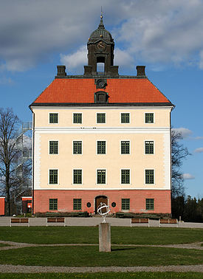
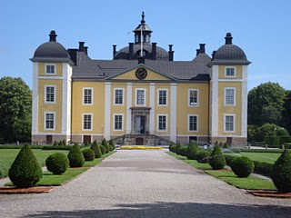
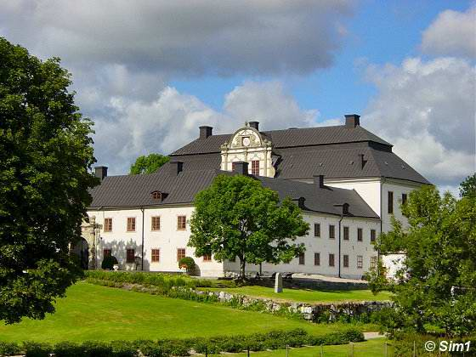
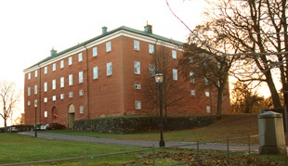
Castle in Västerås
Made by
Hanna Stendahl and Madelene Hellström

Slide 2
Tidö Castle
Tidö castle is not just a castle, it’s also a museum with toys. Car l-David von Schinkel come up with the ideea to make the museum and it was open for the first time 17 juni 1974.
The castle was built in 1620 and it’s the most saved castle in Sweden. Axel oxenstierna, who was Count and statesman in sweden, were one of those who started the construction of the castle.
Axel were maried with Anna Bååt, the one who own the castle. After the maried with Anna Bååt took Axels family over the castle. In 200 yers the castle was owden by the Oxenstiernas family.
1850 the castle was sold for the first time. Carl-David von Shinkle by the castle and even today his family own the castle.

Slide 3
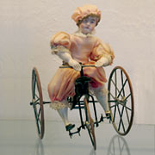
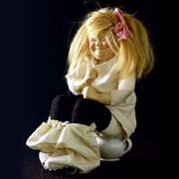
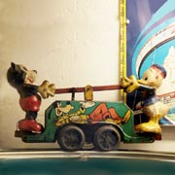
Toys from the museum

Slide 4
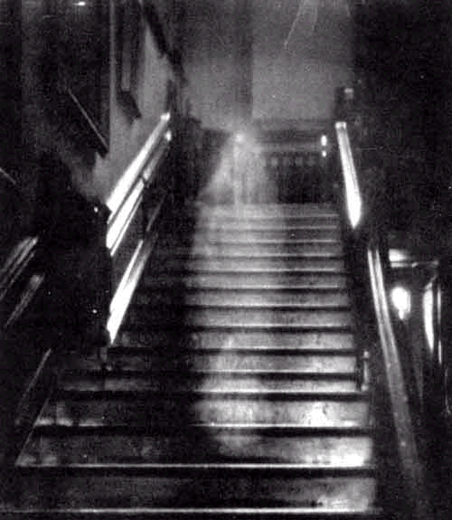
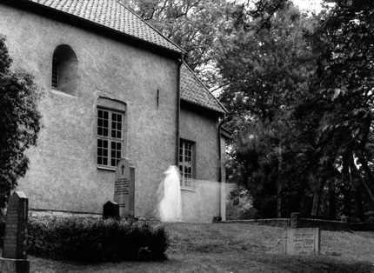
Tidö castle has also a wery intresant story about ghosts. The story is about a little guy named Dificius Dhona. He lived in the castle in the 18o0th and he was a guy who wanted to do everything, even the most scarie things. His father told him about the galleris who was under the castle and he told him that he must promise to never go down there. Do you think that he listen to his father?
No, he did’nt. Dificius went down to the galleris in the middle of the night and he never came up again. He lost himself and starved to death. It’s been said that he still today look after a way to get out.

Slide 5
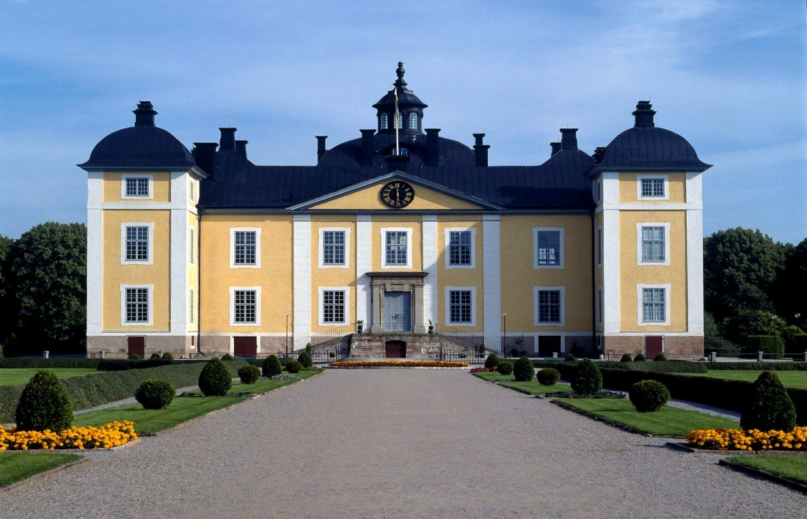
Strömsholms Castle
Strömsholms castle was build 1669-81. The castle was build to Gustav Vasa in the middle of 1500.
the castle has belonged to many women , even Gustav Vasas widow Katarina Stenbock.
Gustav Vasa was a very famous king in Swedish history . It is a very long story bout him and his life. The castle it`s a beautiful place to visit in the summer. You can look at famous old Swedish pictures.

Slide 6
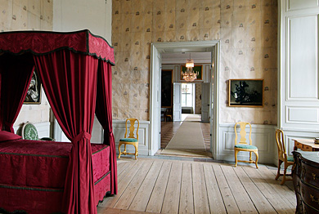
Strömsholms Castle
This is a prins bedroom in Strömsholms Castle.

Slide 7
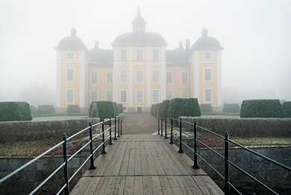
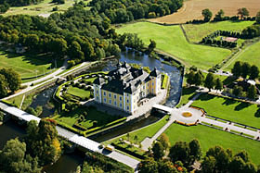
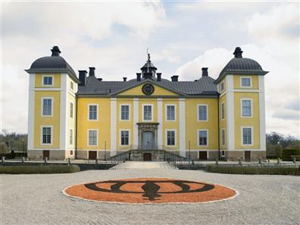
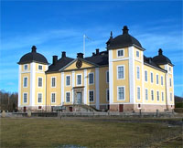
Strömsholm Castle

Slide 8
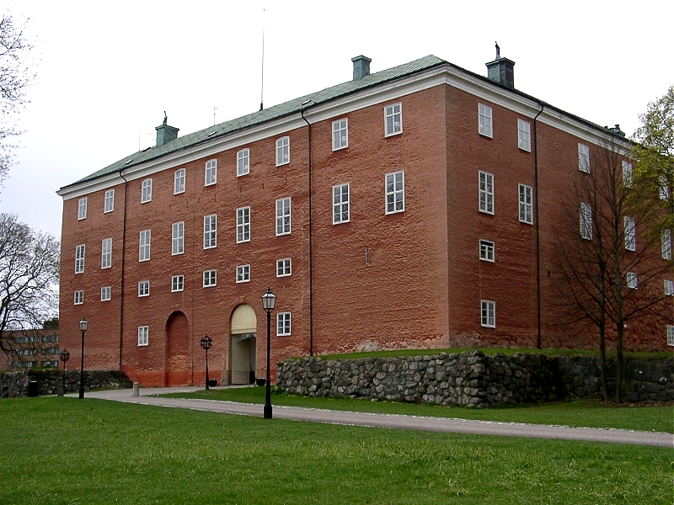
Västerås Castle
Västerås Castle was built in 1240-1259. There were some people who built the castle. Gustav Vasa and Johan III were two of them. The castle has also been a prison, until the 1900th century. The last prisoner left the Castle in 1857.in the 1500th century they built in a strong seven-meter high wall of stone. But now is the castle more like a museum.

Slide 9
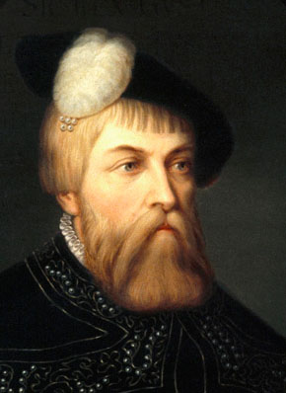
This is Gustav Vasa!

Slide 10
Engsö Castle
Engsö castle is a medieval castle and it was built for many years ago.
In 1185 the castle was owned by a king, named Knut Eriksson. After his dead has over 10 families owned the castle.
The last family lived in the castle until 1959.
Since the castle was in such a poor condition a man named Per Sparre got to rebuild the castle, as at that time was just like a little house.

Slide 11
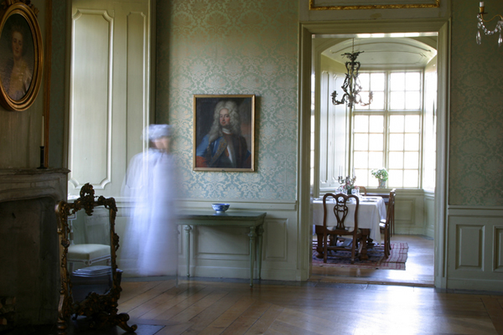
Engsö castle have also a very intresting story about ghosts.
The story is about a woman, named Brita Bååt. It says that she killed two men and she was very mean and strict.
One morning Brita was going to the church. She had told her servant to wake her up in the morning, but Brita woke up in the middle of the night and thougt it was morning and that her servant had forgot to wake her. She hurried to get to the church in time and when she got there the church was already filled with people, or she thougt it was people, but it was’nt. The church was full of ghosts. She had come to the dead peoples mess!
She paniced, and just when she was turning around to run away the two men that she had killed attacked her. One of them swung sword ofter her. and the other one throwed a stone . Brita was lying on the stairs outside the church and she never woke up.

