Slide 1
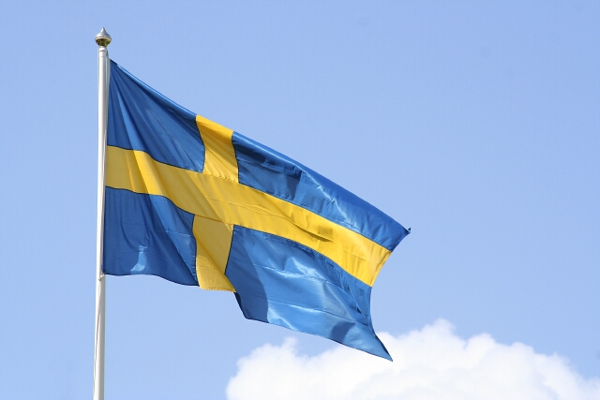
Swedish folk costumes

Slide 2
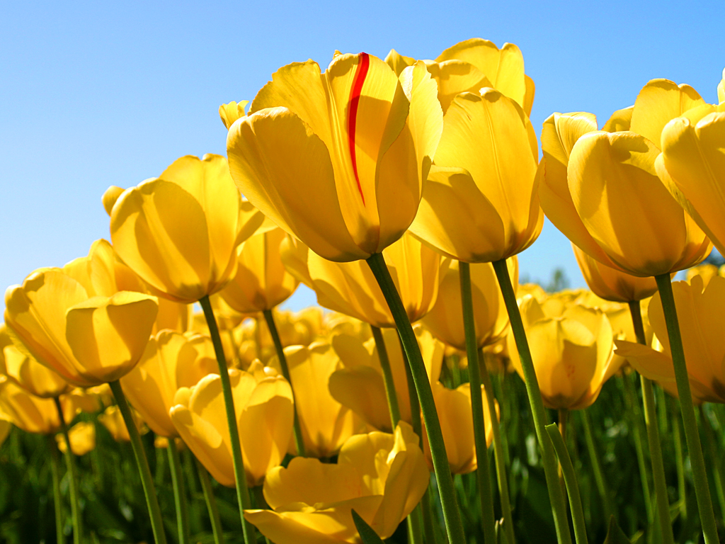
There are different kinds of folk costumes and this is what we call them in Sweden:
"LANDSKAPSDRÄKT"
"SOCKENDRÄKT"
"BYGDE- or HEMBYGDS-DRÄKT"
"HÄRADS-DRÄKT"

Slide 3
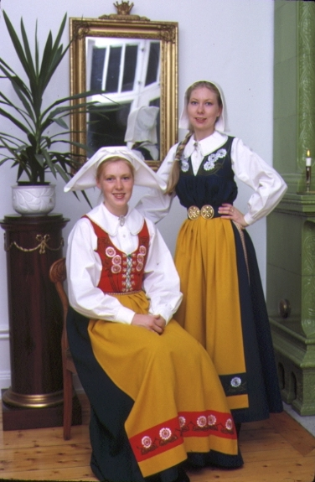
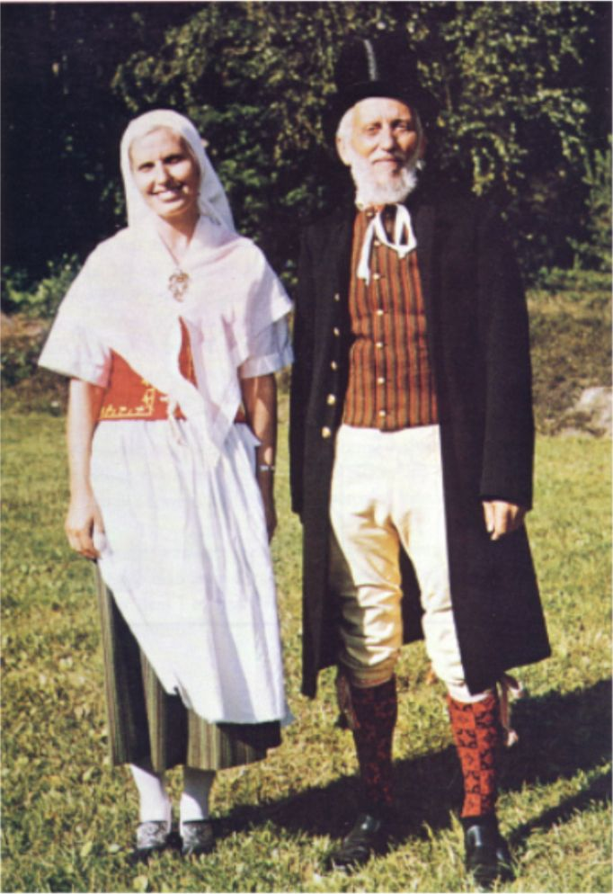
Landskapsdräkt - Costumes from different parts of Sweden

Slide 4
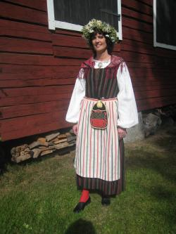
Sockendräkt -Parish Costume
‘
Sockendräkt (parish costume) is another term used for Swedish folk dress.
When the natural boundaries of an area coincided with the parish boundaries, then the local dress of that area became a parish costume ('Sockendräkt') as well as a 'Folkdräkt'.
This is true of many parts of Dalarna.

Slide 5
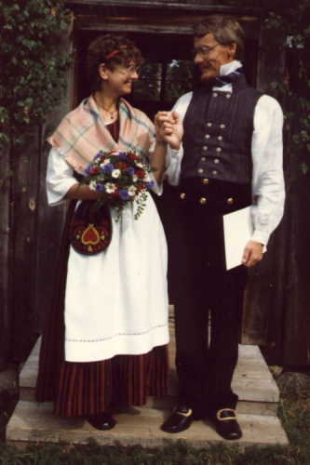
BYGDE- or HEMBYGDS-DRÄKT
Peasants began to imitate the fashions used by the 'Better folk'. And ironically, during this national romantic era, those "better folk" began to dress up as peasants.
At this time the upper classes began to recreate and reconstruct costumes from areas in which they were living, if there was not any locally distinctive costume.
Sometimes several pieces of clothing were found which could be used to reconstruct a costume, at other times perhaps only a piece of headgear was used.
A 'Frame-cap', a traditional piece of headgear, used in both the peasant 'Folkdräkt' as well as the clothing worn by the burghers in the towns, could set the tone for all the other pieces of clothing used in the newly created folk dress.
It was thus a 'Bygdedräkt' or 'Hembygdsdräkt' was born!

Slide 6
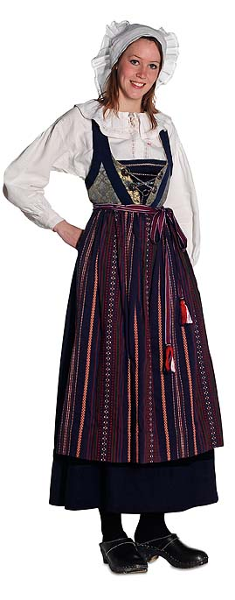
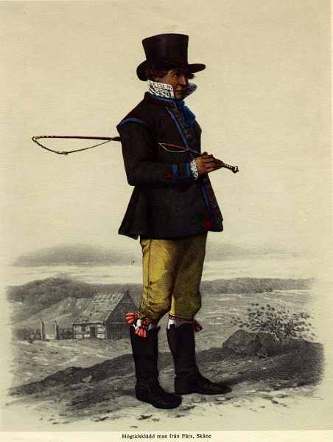
HÄRADS-DRÄKT
Even a 'Häradsdräkt'_ (the 'Härad' is an old jurisdictional unit, composed of several parishes, perhaps most nearly equivalent in size to an American county) can also be a 'Folkdräkt', if the natural boundaries of an area coincided with the 'Härad's' boundaries.

Slide 7
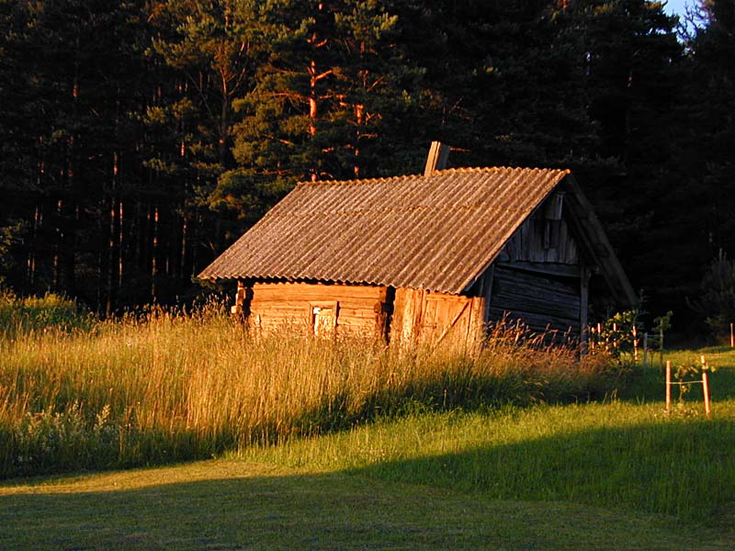
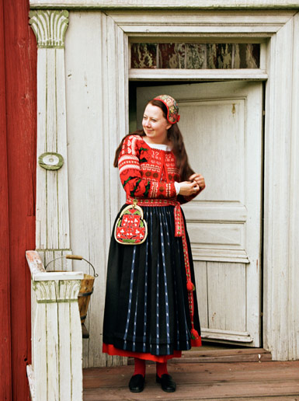

Slide 8
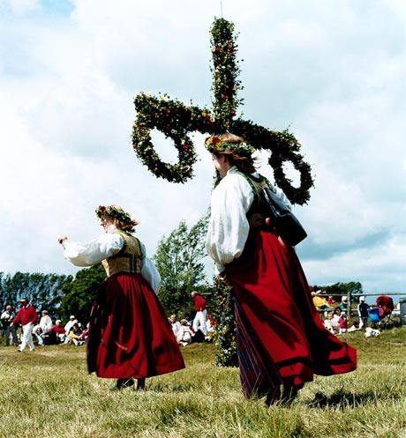
Made by:
Jacqueline Lundgren
Linnea Jonsson
Josefine Nilsson
Angelica Johansson
Elina Abramian
Rebecka Garside
Arvin Omari
Philong Tran

