Slide 1
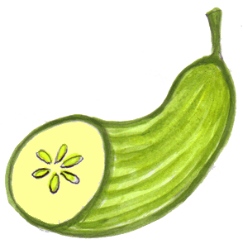
Västerås – the Cucumber city
Here are some Facts about Sala Silver Mine.

Slide 2
SALA SILVER mine
Sala silver mine was founded in 1624
Thousands of workers worked hard every day in the mine
During a long time Sala silver mine was the biggest producer of silver in Europé
The mine was open in 400 years
The silver mining closed in 1908
During 1540 Sala silver mine could produce up to 3,5 tons of pure silver
The mine galleries were up to 20 km long
Sala silver mine has one of the best preserved and safest mind environments. s

Slide 3
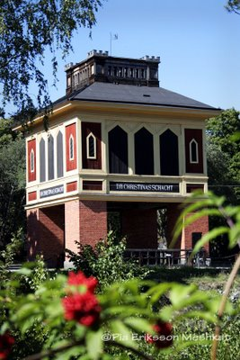

Slide 4
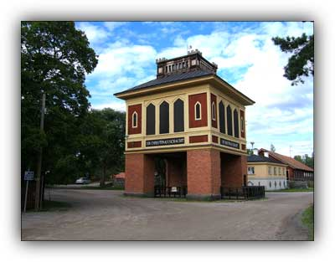
Shacks in Sala silver mine.
The deepest schack in the mine is karl schack.
Every schack is named after famous people in Sweden.
The famous people are royalties
The karl schack is 318m deep.
A couple of the names is queen Christina Gustav the third and king Karl.
There are many elevators in the mine.
The elevators take you to the different shacks in the mine. M

Slide 5
Pure facts about the mine
In 1950 they did some excavations in the mine, and they found some house walls.
The scientists thought that the people lived there under the time that Sala silver mine was mining silver.
The people in the mine drank alot, they could drink up to 70 barrels per week.
And the year after that the people in the village could drink up to 110 barrels per week.
But the village growed and became many more peoples the year after. S

Slide 6
V I D E O
http://www.youtube.com/watch?v=QOmpQ6jZ3Ws

Slide 7
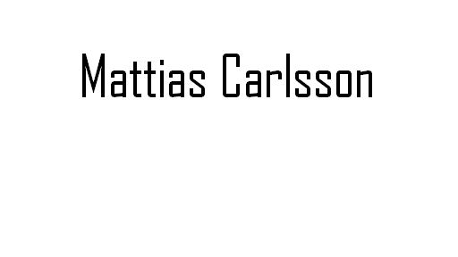
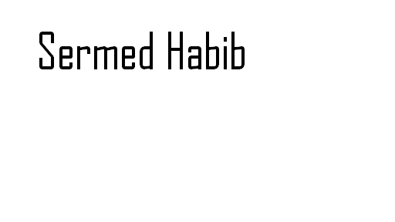
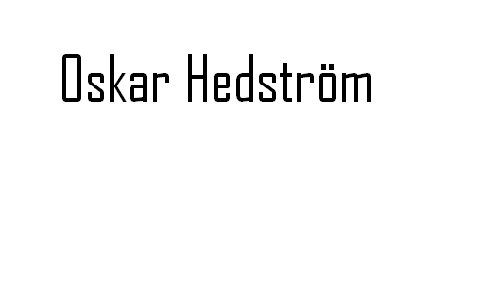
MADE BY :

